Slide 1
Natural Language Processing (NLP)
Lecture 11: Document Classification
Dr. Muhammad Taimoor Khan

Slide 2
Nearest Neighbor Classifier
Calculate distance of the test document with all the training documents.
The training document that has the shortest distance (or highest similarity) with the test document has its label assigned to the test document.

Slide 3
Nearest Neighbor Classifier
10
9
If the nearest document to the previously unseen document is a physics
class is physics
else
class is chemistry
8
7
6
Frequency
5
4
3
2
1
physics
chemistry
1
2
3
4
5
6
7
8
9
10
Word IDs

Slide 4
We can visualize the nearest neighbor algorithm in terms of a decision surface…
Note the we don’t actually have to construct these surfaces, they are simply the implicit boundaries that divide the space into regions “belonging” to each instance.
This division of space is called Dirichlet Tessellation (or Voronoi diagram, or Theissen regions).

Slide 5
The nearest neighbor algorithm is sensitive to outliers…
The solution is to…

Slide 6
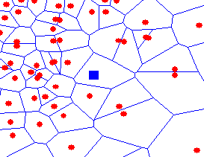
We can generalize the nearest neighbor algorithm to the K- nearest neighbor (KNN) algorithm.
We measure the distance to the nearest K instances, and let them vote. K is typically chosen to be an odd number.
K = 1
K = 3

Slide 7
K-Nearest Neighbor
Voting among K nearest neighbors (One example may not be enough for decision making)
Makes no special attempt to learn (Model) from the data
Provides no special value in finding generalized patterns
A type of Instance based learning
Instead of performing explicit generalization, compare new instances with instances in training data

Slide 8
Choosing the value of K
Too small: sensitive to noise
Too large: may include points from other classes
Fine tune values by evaluating various values with cross validation

Slide 9
Normalization
To bring different attribute values to the same scale [0, 1].
Any given range can be adjusted to have the lowest value set to 0 while the highest set to 1.
Allows to balance the impact of each attribute on the final classification

Slide 10
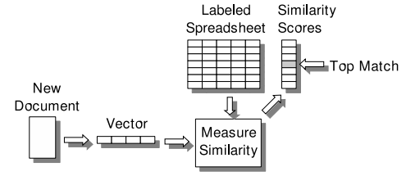

Distance Measure
Document to document distance / similarity
Distance measures:
Manhattan $Dist\left(x,y\right)=\left|x_{1}−y_{1}\right|+\left|x_{2}−y_{2}\right|+…+\left|x_{n}−y_{n}\right|$
Euclidean $Dist\left(x,y\right)=\sqrt{\sum_{i=1}^{n}{{(x_{i}−y_{i})}^{2}}}$
Cosine similarity

Slide 11
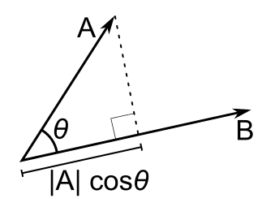

Why cosine similarity!
Unlike other distance measures, it is least effected by the frequency change of the occurring words
Cosine similarity
$$\cos\left(Ө\right)=\frac{\sum_{i=1}^{n}{x_{i}y_{i}}}{\sqrt{\sum_{i=1}^{n}{x_{i}^{2}}}\sqrt{\sum_{i=1}^{n}{y_{i}^{2}}}}$$

Slide 12
Instance vs Model based Learning
Instance based Learning
Also called memory based learning
No model to learn, the stored instances themselves represent the knowledge
Training instances are searched for new instance so that most closely resemble new instance (Just a retrieval program under the best circumstances)
Lazy learning
Model based Learning
Produce a generalized rules to learn a model from the data
The training data is not required once the model is trained

Slide 13
Parametric vs Non-parametric
Parametric Learning (parameters to tune)
Make assumptions about mapping of input variables to output variables
The assumptions simplify the learning process (to a known form) but limits the learning

Slide 14
Summarize data into a set of parameters of fixed size
It has two steps
Select a form for the function
Learn the coefficients (weights) for the function from the training data
Linear classification, Neural Networks, Naïve bayes

Slide 15
Non-parametric Learning (No parameters to tune)
Make fewer or no assumptions about the target function and in turn require a lot of training data
Are free to learn any functional form from the data
Are slower to train and have high model complexity

Slide 16
But can result in more powerful models
Not concerned about choosing the right features
Examples: KNN, Decision tree, SVM

Slide 17
Other classifiers: Naïve Bayes
Calculate probabilities for document labels and the words occurring in documents of those labels
Each word indicate a document label with some probability
The label probabilities of words in the test document are accumulated to predict a label for the test document

Slide 18
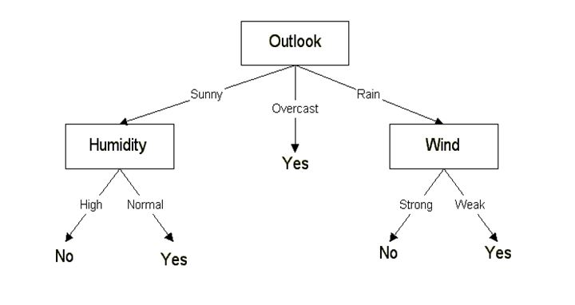
Decision Tree
Input at root is a test document
The intermediate nodes represent conditions on attributes
The leaf nodes are the possible labels

Slide 19
Linear Classifier
10
9
Draw a straight line among the two types (label) of documents
The test document is labeled based on which side of the line it lies.
w₀+w₁x₁ + w₂x₂ = b
8
7
6
5
4
3
2
1
1
2
3
4
5
6
7
8
9
10

Slide 20
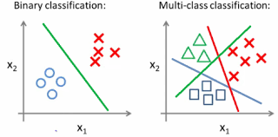
Multi-class Classification
We may have to choose among multiple labels

